Slide 1

Establishment
Good Morning Saints
Sunday Dec. 14, 2025
  Hard to believe almost 2026!
  FLEW BY!
  At the beginning again
Imone
Wisdom Seekers @TFC
Cold and Blustery
Marathon

Slide 2
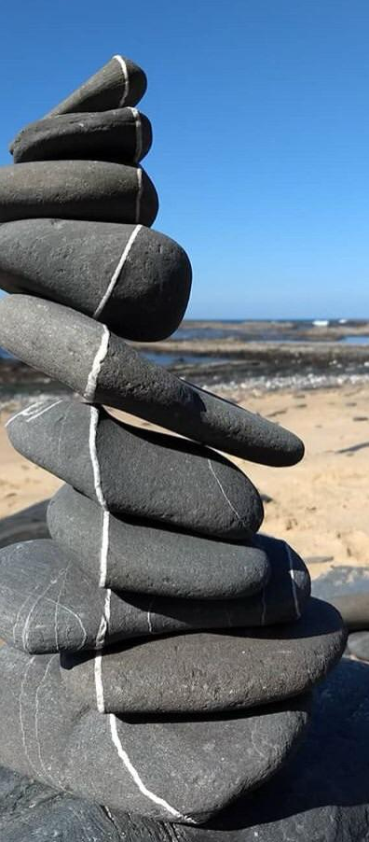
Class Participation Sector:
What are some things that God establishes?
PEOPLE
PLACES
HIS WILL/WAYS

Slide 3

ESTABLISHMENT: MODERN ENGLISH
Something established like a settled arrangement
An established church
  Quote from a guy who chronicles scientology- “established church “🥸
Civil or military organization
A place of business, or residence
Public or private institution
A group of social, economic, and political leaders who form a ruling class of a nation
  Pneumatikos brain says that sounds like an Ekklesia!

Slide 4
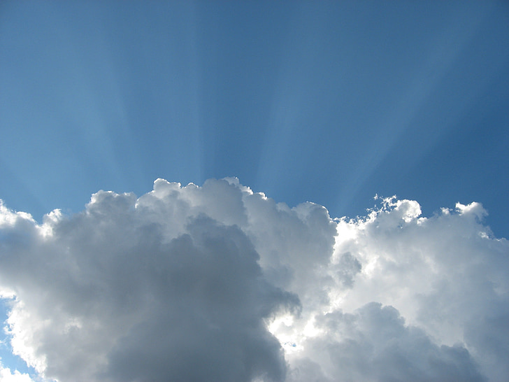
Refresher:
What is an Ekklesia?
22 Then tidings of these things came unto the ears of the church which was in Jerusalem: and they sent forth Barnabas, that he should go as far as Antioch. 23 Who, when he came, and had seen the grace of God, was glad, and exhorted them all, that with purpose of heart they would cleave unto the Lord.
24 For he was a good man, and full of the Holy Ghost and of faith: and much people was added unto the Lord 😆
25 Then departed Barnabas to Tarsus, for to seek Saul: 26 And when he had found him, he brought him unto Antioch. And it came to pass, that a whole year they assembled themselves with the church, and taught much people. And the disciples were called Christians first in Antioch.
Acts 11:22-26 (KJV)
Context- After Stephen 🪦 Disciples are scattered ( to Phenice, and Cyprus) preach to Jews only. Then to Grecians in Antioch. Many were saved. The Lord was near

Slide 5
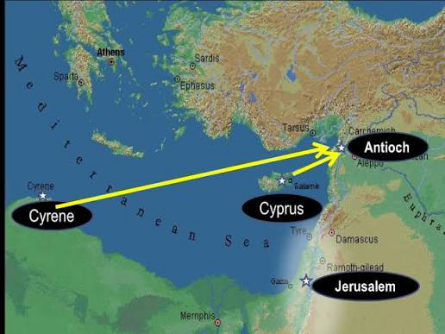

Slide 6
Class Participation 🚨
Where were people first called Christians?
How many times does the word “Christians” appear in the Bible?
ANTIOCH:
3 TIMES

Slide 7
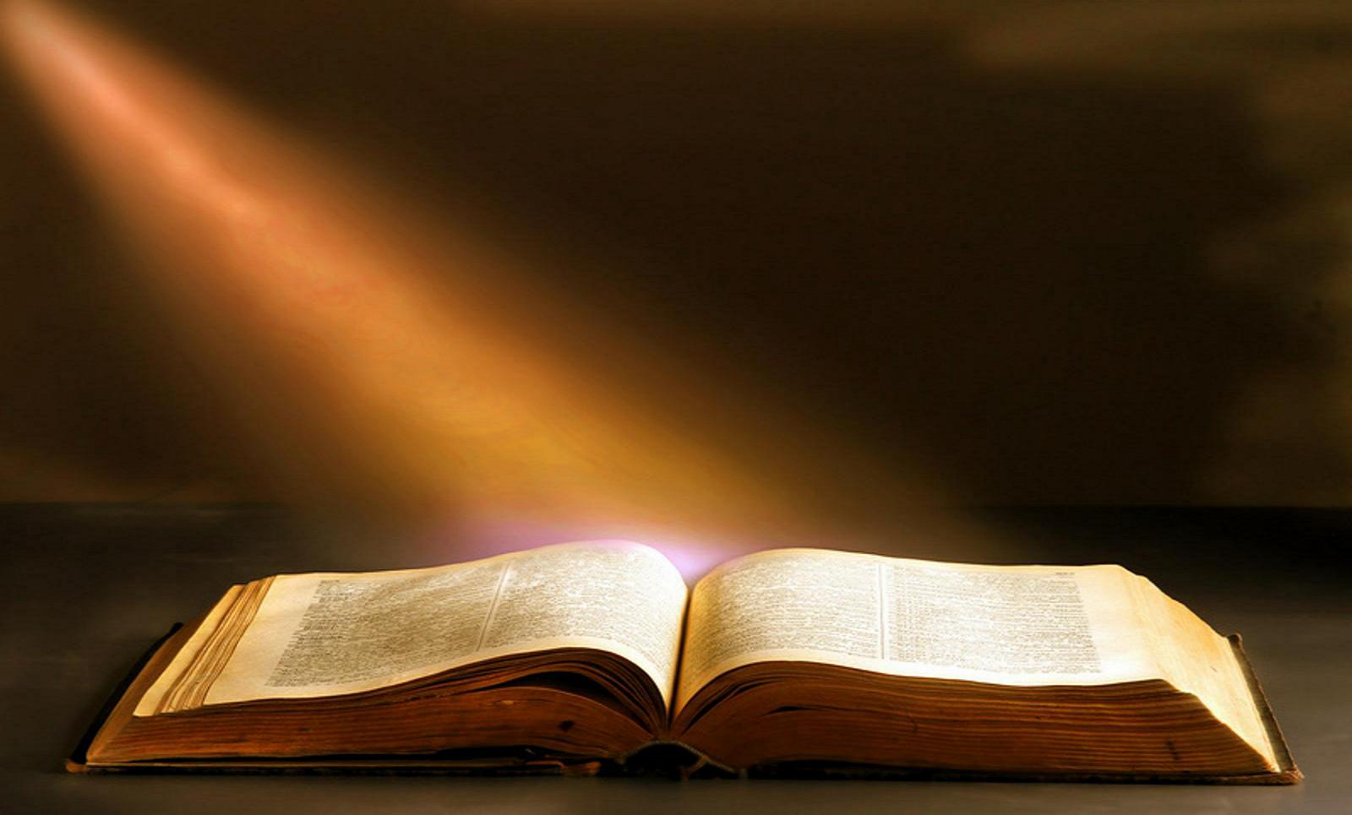
Refresher:
What is an Ekklesia?
THIS IS AN EKKLESIA
It is a people group ESTABLISHED by God to rule
g1577. ἐκκλησία ekklēsia; CHURCH
The called out ones who institute Kingdom business on behalf of the authority of the Throne of God for a region on behalf of His purposes.
Christian community of members on earth or saints
Assembly
  Gathering of citizens called out from their homes into some public place to council for the purpose of deliberating.
  Manage their own affairs, according to regulations prescribed for the body for order's sake.
  Those who are united into one body.
      The whole body of Christians scattered throughout the earth

Slide 8
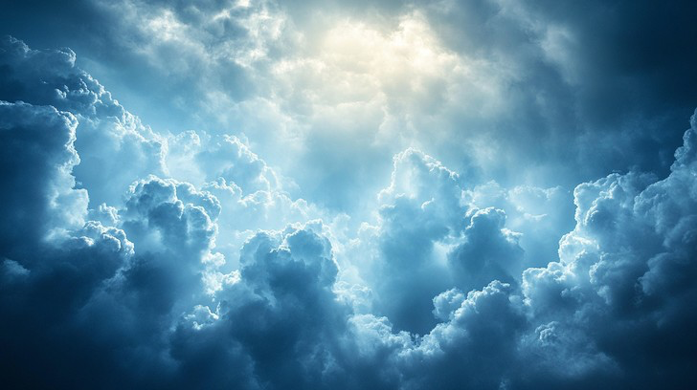
NT Greek: ἐκκλησία (ekklesia) —called out ones
HAS AN OLD TESTAMENT EQUIVALENT
Hebrew (qāhāl) — assembly, congregation, summoned
Psalms 89:4-7
4 Thy seed will I establish for ever, and build up thy throne to all generations. Selah. 5 And the heavens shall praise thy wonders, O LORD:thy faithfulness also in the congregation of the saints.6 For who in the heaven can be compared unto the LORD?who among the sons of the mighty can be likened unto the LORD?7 God is greatly to be feared in the assembly of the saints, and to be had in reverence of all them that are about him.

Slide 9
Class Participation 🚨
Conceptually, what is the Old Testament equivalent of Ekklesia?
QUAHAL

Slide 10
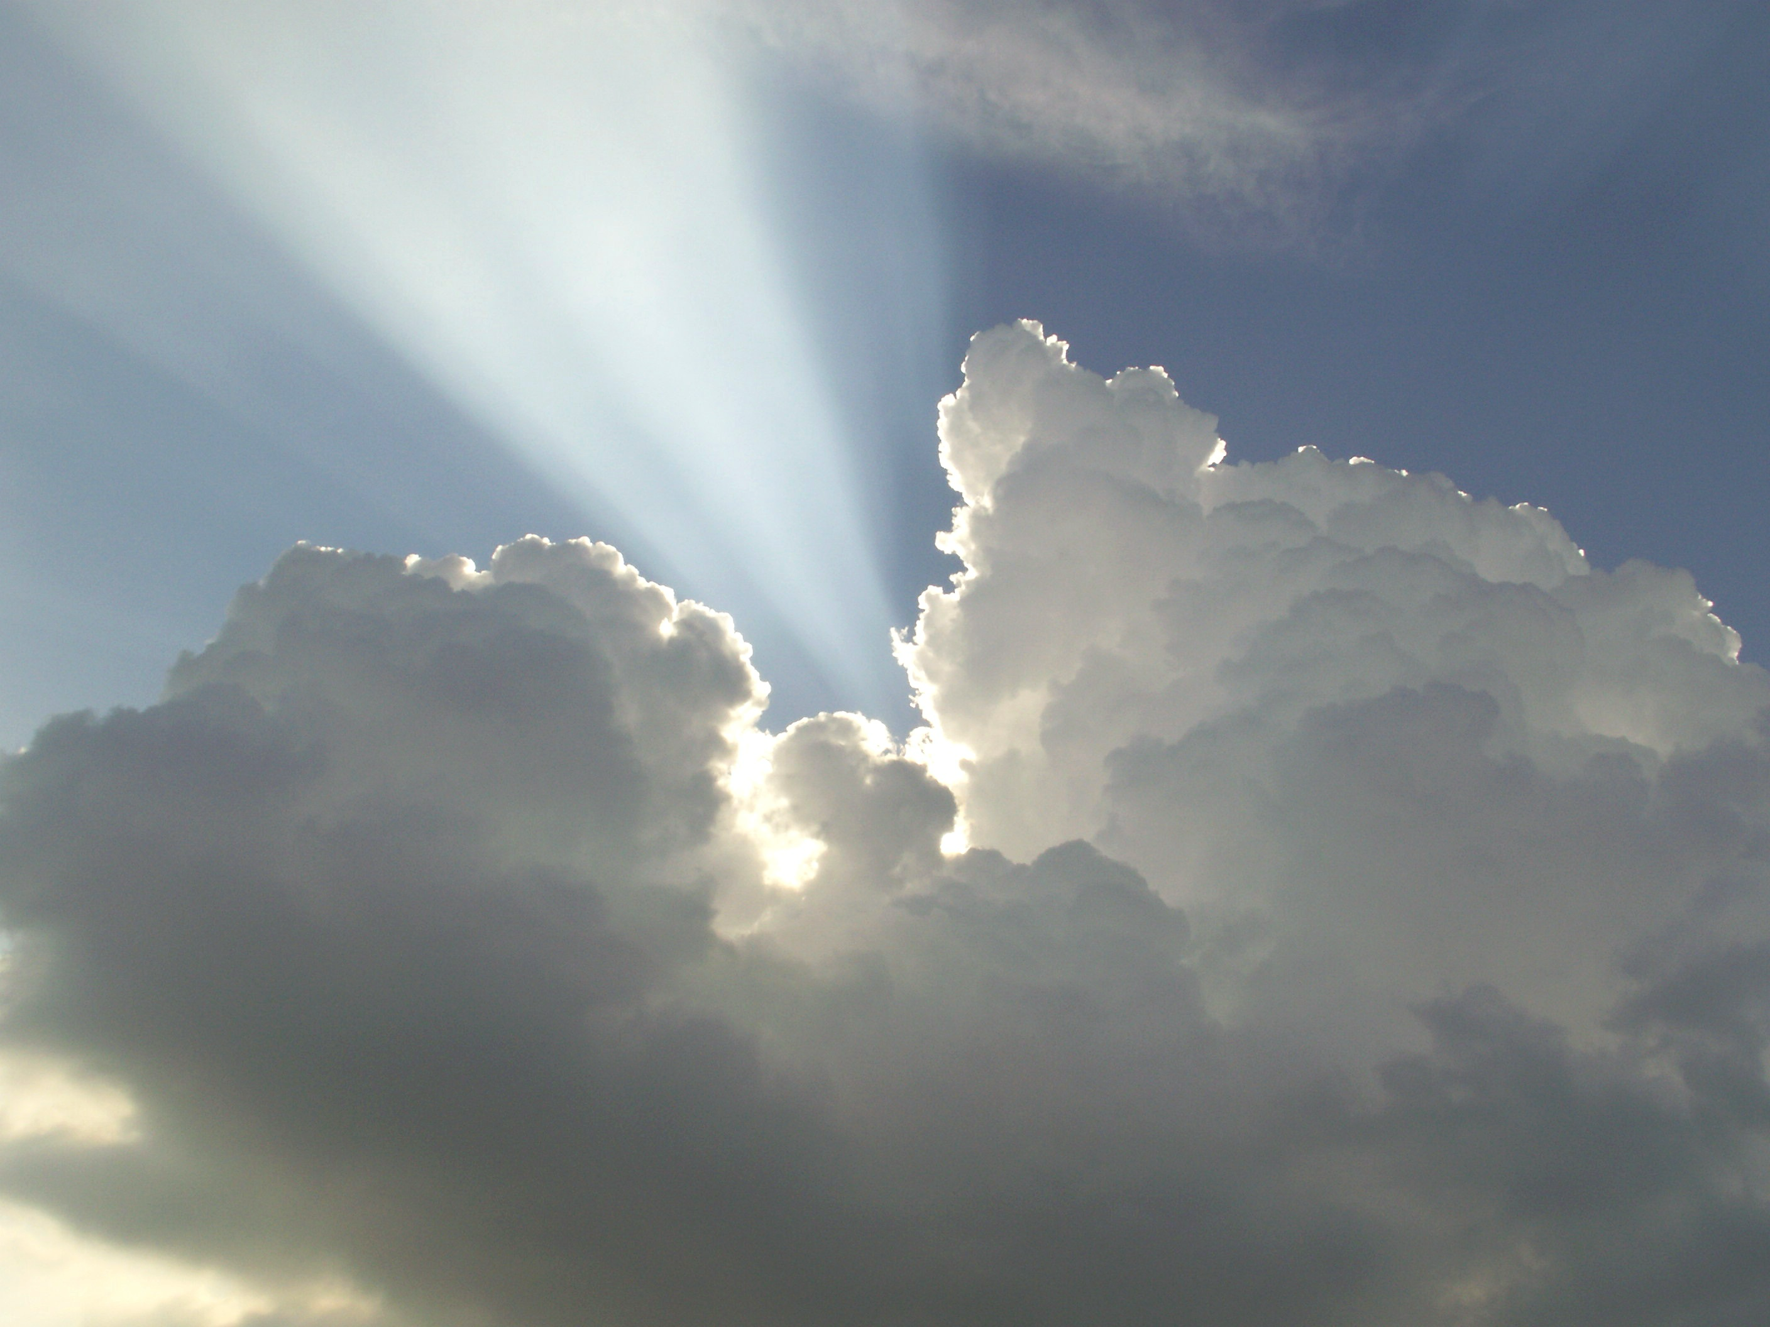
Let’s continue our study of Establishment
2 Chronicles 31: 20-21
20 And thus did Hezekiah throughout all Judah, and wrought that which was good (TOWB- Harmonious unity and function- On one accord with God and His will )
and right (YASAR straight and upright- Pleasing and correct)
and true (EMET-True/truth in the OT, means stability. From the root word Aman. It’s the fulfillment of what God has shown during commune at the right hand. It is the completion of the aman)before the LORD his God.
21 And in every work that he began in the service of the house of God, and in the law, and in the commandments, to seek his God, he did it with all his heart, and prospered.
Context: Hezekiah destroys all of the high places. He reinstitutes the priests, the children of Israel turn to God again, and serve Him with their whole hearts
HEAPS- BLESSING
GOD ESTABLISHES PEOPLE WHO ARE WHOLLY DEVOTED TO HIM

Slide 11
Class Participation 🚨
What is the root word of Emet which means Truth and at the right hand?
AMAN

Slide 12

1- After these things, and the establishment thereof, Sennacherib king of Assyria came, and entered into Judah, and encamped against the fenced cities, and thought to win them for himself.
2- And when Hezekiah saw that Sennacherib was come, and that he was purposed to fight against Jerusalem, 3-He took counsel with his princes and his mighty men to stop the waters of the fountains which were without the city: and they did help him.
4-So there was gathered much people together, who stopped all the fountains, and the brook that ran through the midst of the land, saying, Why should the kings of Assyria come, and find much water?
5-Also he strengthened himself, and built up all the wall that was broken, and raised it up to the towers, and another wall without, and repaired Millo in the city of David, and made darts and shields in abundance.
6- And he set captains of war over the people, and gathered them together to him in the street of the gate of the city, and spake comfortably to them, saying,
7-Be strong and courageous, be not afraid nor dismayed for the king of Assyria, nor for all the multitude that is with him: for there be more with us than with him:
8-With him is an arm of flesh; but with us is the LORD our God to help us, and to fight our battles. And the people rested themselves upon the words of Hezekiah king of Judah.
We’re going to read the rest
2 Chronicles 32: 1-8
This is what establishment looks like. The Lord establishes

Slide 13
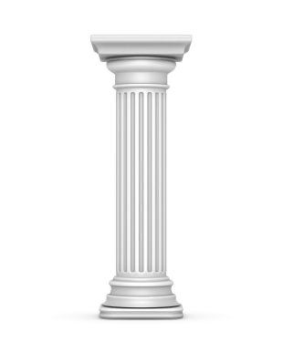
ESTABLISHMENT: A CONCEPT STUDY
Emet-meaning truth, true or stability. It is the completion of the aman.
PILLAR- STYLOS (g4769)
meaning to stiffen or support.
NT Greek word
It depicts a hollow instrument by which some type of fluid is drawn for a particular purpose. The pillar is not load-bearing, but a conduit of obedience
presence, supply and power of God are conveyed.
The ekklesia is to be a pillar of truth and grounded in truth (the unveiling of revelation) and in ongoing contact between heaven and earth so we know what is occurring in heaven. As individuals, we should faithfully stand as pillars in our tereo as a touch point between heaven and earth.
NT Stylos pairs with the OT Heb. word histemi.
As pillars in the Temple, we have been given authority to draw from the histemi where we have been placed.
The original reason for a pillar is to show the earth who God is.
ESTABLISHMENT
EKKLESIA
PARTNERSHIP
BREAKTHROUGH
Aman-sure, faithful, establishing, to the right
TEREO & HISTEMI

Slide 14
ESTABLISHMENT
STYLOS- PILLAR
GROUNDED IN TRUTH- EMET
COMES FROM THE AMAN – RIGHT HAND
AS A CONDUIT- DRAWING HIS POWER, AUTHORITY & SUPPLY
FROM OUR TEREO
IN OUR HISTEMI
AS THE EKKLESIA
TO ACCOMPLISH HIS WILL ON THIS EARTH

